Slide 1
COVID-19 IMPACT ON STOCK PRICES
Donna Benitez
Krishna Piratla
Valentina Gonzalez

Slide 2
Problem
Stock market prediction is a major challenge
A lucrative research area
Notes:
prediction is a major challenge owing to non-stationary, blaring and chaotic data.
For the same reason it has always been a lucrative research area given its potential to reap high rewards.

Slide 3
Problem
The COVID situation only added to the chaos.
Interesting to see impact of covid on various companies
Methodology: build models using pre-covid data; compare their predictions with actual post-covid data.
Notes:
It impacted some companies quite badly and others not so much.
It would be interesting to look at the qualitative impact of COVID on the stock prices of various companies to see how they have been impacted by this pandemic situation.
The idea is to build models using pre-covid data and compare their predictions with actual post-covid data.

Slide 4
Dataset
Source: Quantmod package.
Pre-Covid: 1/1/15 to 02/28/20
Post-Covid: 3/1/20 to 04/21
Notes:
Used Closing Prices for the purpose of analysis in this project

Slide 5
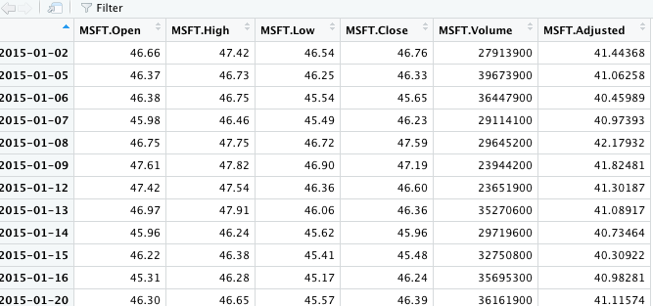
Dataset
Notes:
This is a sample snippet of how our datasets look like.

Slide 6
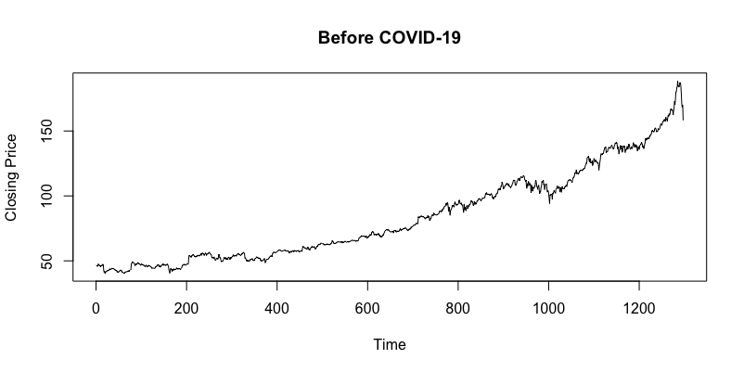
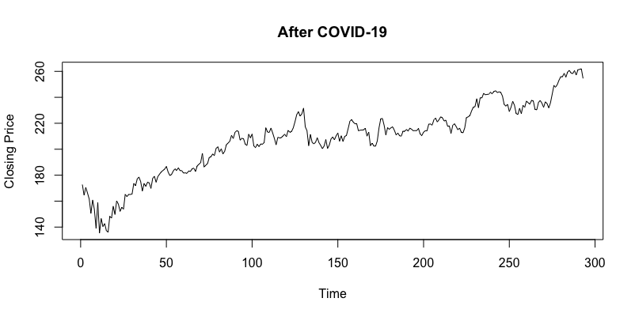
Graphical Representation: MSFT stock prices pre and post COVID

Slide 7
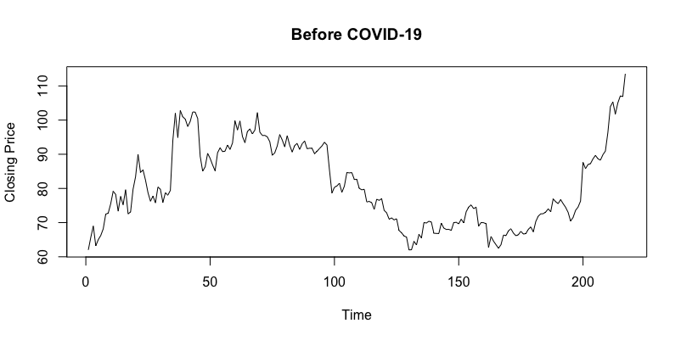
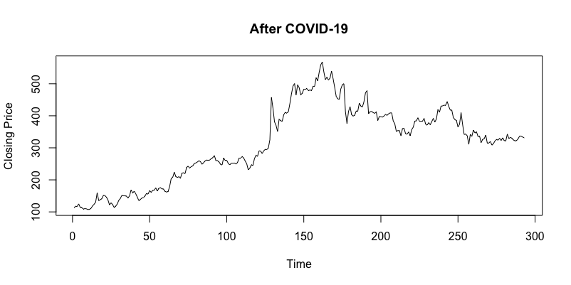
Graphical Representation: ZM stock prices pre and post COVID

Slide 8
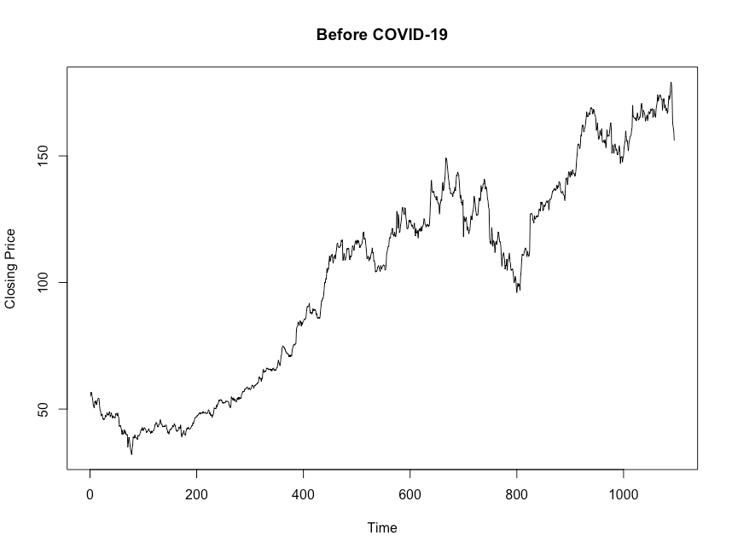
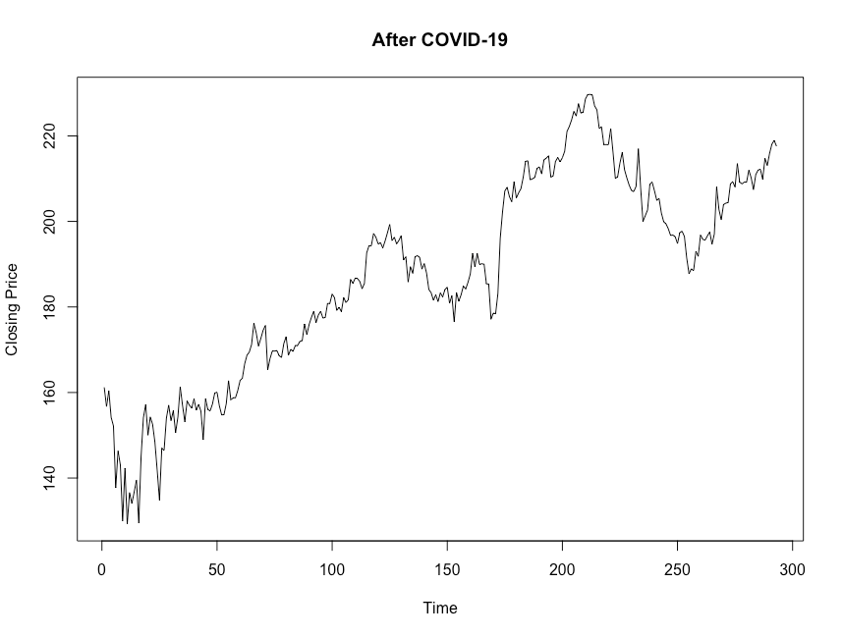
Graphical Representation: RACE stock prices pre and post COVID

Slide 9
Methods used
ARIMA
K-Nearest Neighbours (KNN) Model
Neural Network
Long Short Term Memory (LSTM) Model (Implemented later .. after the feedback)
Notes:
(chose ARIMA because ARIMA is usually considered a good model for stock data and it could be a decent benchmark just in case...

Slide 10
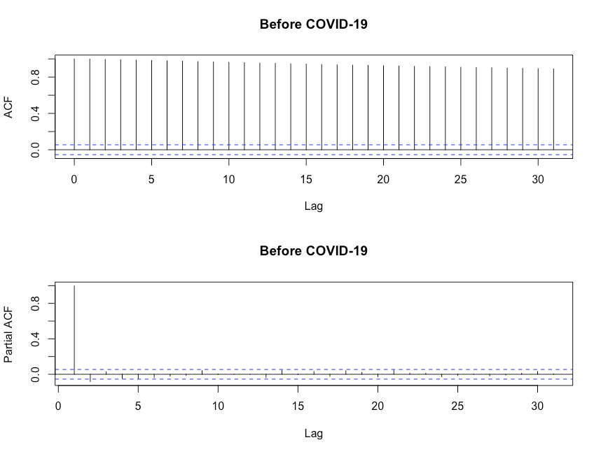
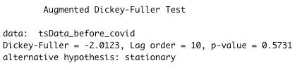
Started with MSFT...
Confirmed the non-stationarity of the data
Non-stationary data
Notes:
We started our analysis with MSFT to confirm our methodology.
Initially we wanted to check whether the data was stationary or non-stationary.
We looked at the ACF and the PACF plots and performed the ADF test. The tests indicated that the data was indeed non-stationary

Slide 11
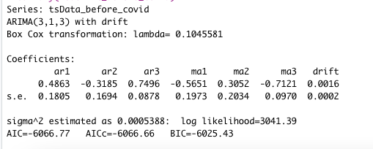
Started with MSFT: ARIMA
Fit ARIMA model using auto.arima()
ARIMA (3,1,3)
Notes:
So, we used the auto arima function to fit an ARIMA model on the time series data
The function returned an ARIMA(3,1,3) as the best model for this data.

Slide 12
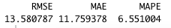
Started with MSFT: KNN
k value chosen to be approx. square root of number of data points
k = 36
number of values to forecast, h = 30
Notes:
Then we fit the KNN model on the stock data with parameters k = 36 and h = 30, and we plotted the predictions.

Slide 13
Started with MSFT: Neural network
Number of nodes = 56
Lambda value has been estimated using the BoxCox lambda function
Notes:
Then we fit a single layer neural network model with 56 nodes and lambda value estimated using the BoxCox function.

Slide 14
How these Methods compare
Notes:
Then we looked at the Root Mean Square Error, Mean Absolute Error and the Mean Absolute Percentage Error for these 3 models.
As you can see, ARIMA and Neural Network models performed quite similarly. So, We'll use Neural network model to get the predictions and compare with actual values for a range of 30 days starting from 2nd March 2020.

Slide 15
Predicted vs. Actual Prices
Notes:
This is a snippet of comparison between the predicted values and the actual values of MSFT

Slide 16
Observations and Conclusion
Observation: MSFT has performed better than predictions for the initial few days but later performed much worse than the predictions than the remaining time.
Reasoning: The model is built on pre-covid data. So, it's predictions do not include the impact due to Covid situation
Conclusion: MSFT was likely impacted negatively due to Covid.
Notes:
From this comparison we could see that

Slide 17
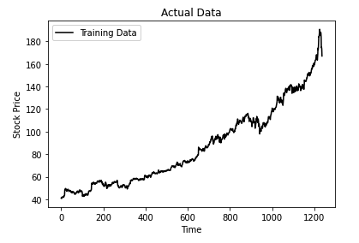
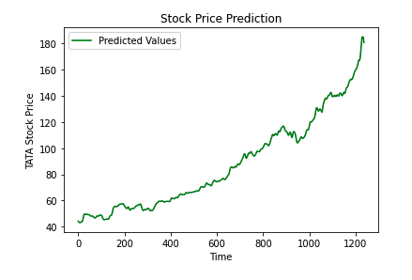
Verifying our conclusion with LSTM Model...
LSTM model was also built on pre-covid data; so, it’s predictions do not take into account the impact of covid.
LSTM model too predicts higher stock price post covid. Therefore, a lower actual stock price indicates that covid impacted MSFT negatively
Notes:
LSTM model was also built on pre-covid data; so, it’s predictions do not take into account the impact of covid.
LSTM model too predicts higher stock price post covid. Therefore, a lower actual stock price indicates that covid impacted MSFT negatively

Slide 18
Next...
We adopted the same methodology and performed similar analysis for two more companies:
Ferrari – Luxury Automobile Company
Zoom – Video Communication Technology Company
In both these cases as well, the Neural Network model performed the best (along with ARIMA)
We chose the Neural Network model to compare the predictions and the actual results.

Slide 19
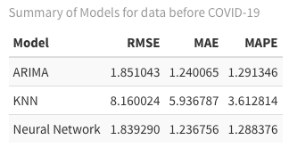
Results: RACE (Ferrari)

Slide 20
Observations and Conclusion
#Observation: RACE has performed better than predictions initially but eventually became worse than predictions
#Reasoning: The model is built on pre-covid data. So, it's predictions do not include the impact due to Covid situation
#Conclusion: RACE was likely impacted negatively due to Covid.

Slide 21
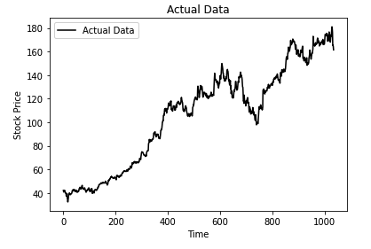
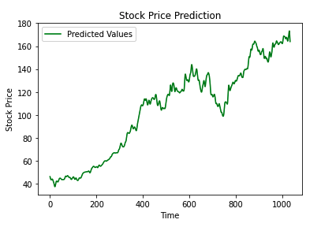
Verifying our conclusion with LSTM Model...
LSTM model was also built on pre-covid data; so, it’s predictions do not take into account the impact of covid.
LSTM model too predicts higher stock price post covid. Therefore, a lower actual stock price indicates that covid impacted RACE negatively
Notes:
LSTM model was also built on pre-covid data; so, it’s predictions do not take into account the impact of covid.
LSTM model too predicts higher stock price post covid. Therefore, a lower actual stock price indicates that covid impacted MSFT negatively

Slide 22
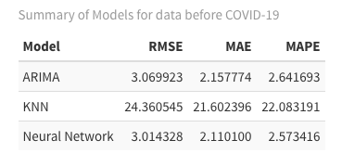
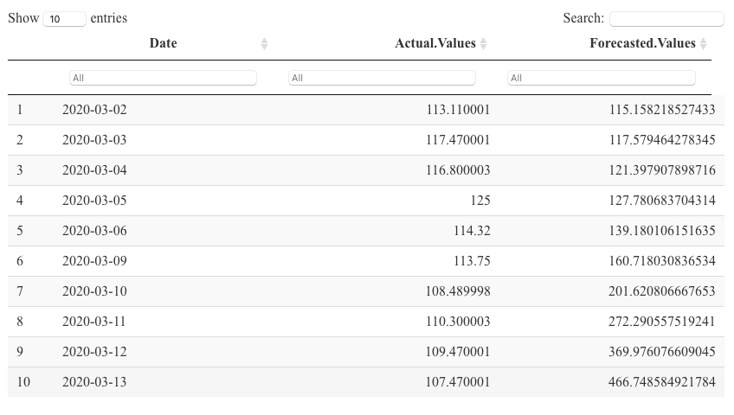
Results: ZM (Zoom)

Slide 23
Observations and Conclusion
#Observation: ZM has performed worse than predictions
#Reasoning: The model is built on pre-covid data. So, it's predictions do not include the impact due to Covid situation
#Conclusion: ZM was likely impacted negatively due to Covid.

Slide 24
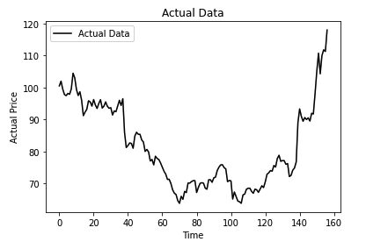
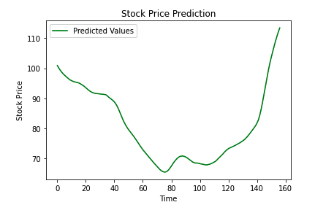
Verifying our conclusion with LSTM Model...
LSTM model was also built on pre-covid data; so, it’s predictions do not take into account the impact of covid.
LSTM model too predicts higher stock price post covid. Therefore, a lower actual stock price indicates that covid impacted RACE negatively
Notes:
LSTM model was also built on pre-covid data; so, it’s predictions do not take into account the impact of covid.
LSTM model too predicts higher stock price post covid. Therefore, a lower actual stock price indicates that covid impacted MSFT negatively

Slide 25
Final findings

